Slide 1
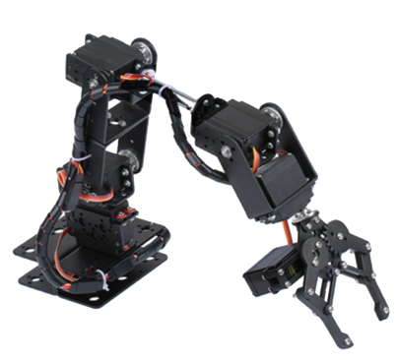
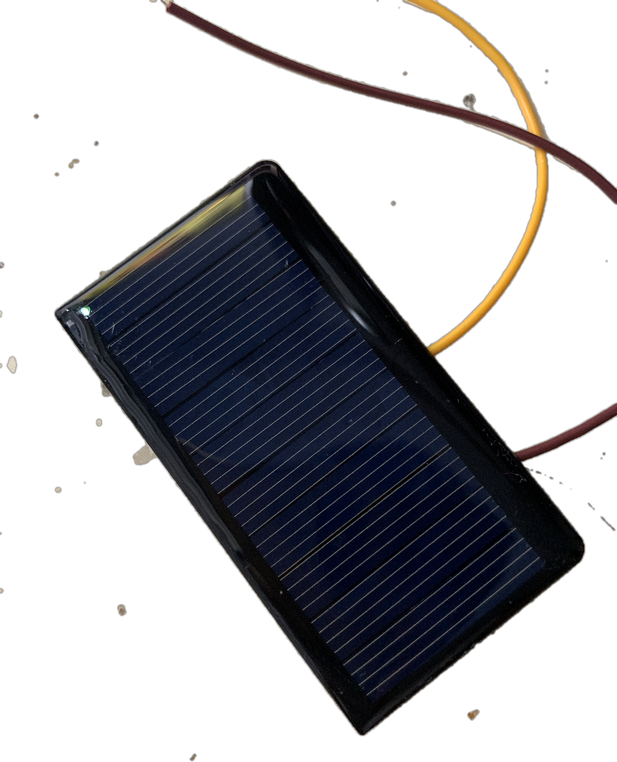
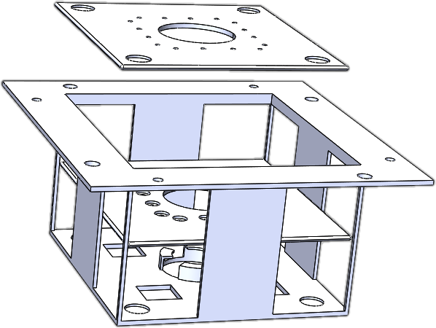
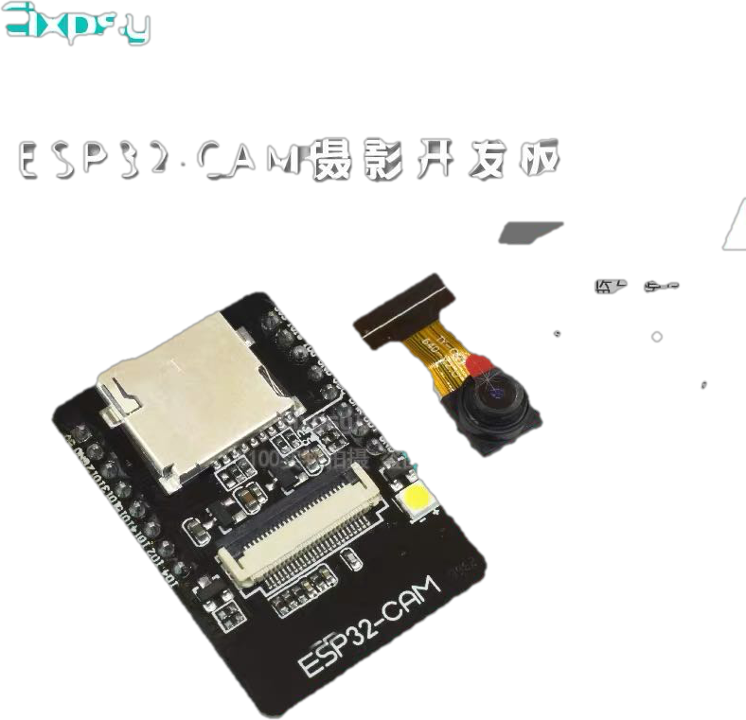
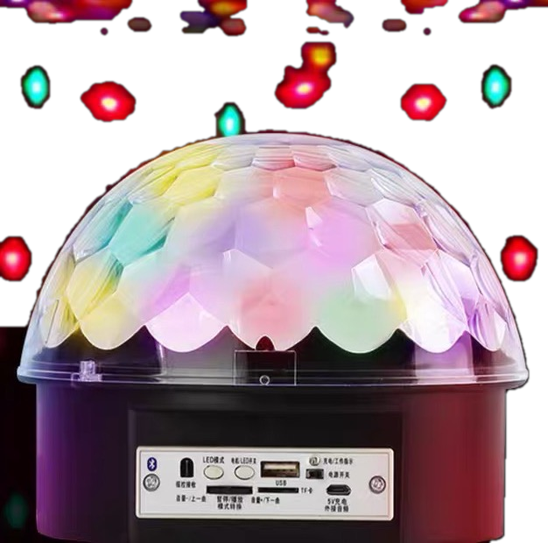
Functions
Robotic Arm
Solar Power
Modules
Camera
Universal Plug
Karaoke

Slide 2
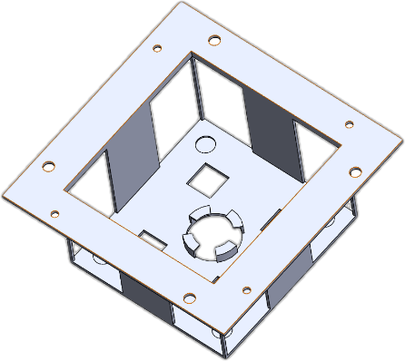
Functions
The Universal Plug
The Stable Basis for Every Module
Power and I/O Port
Electromagnet— Fix & Unfix
Spring— Avoid Poor Contact
Electromagnet
Module
Metal piece
CPU/Power

Slide 3
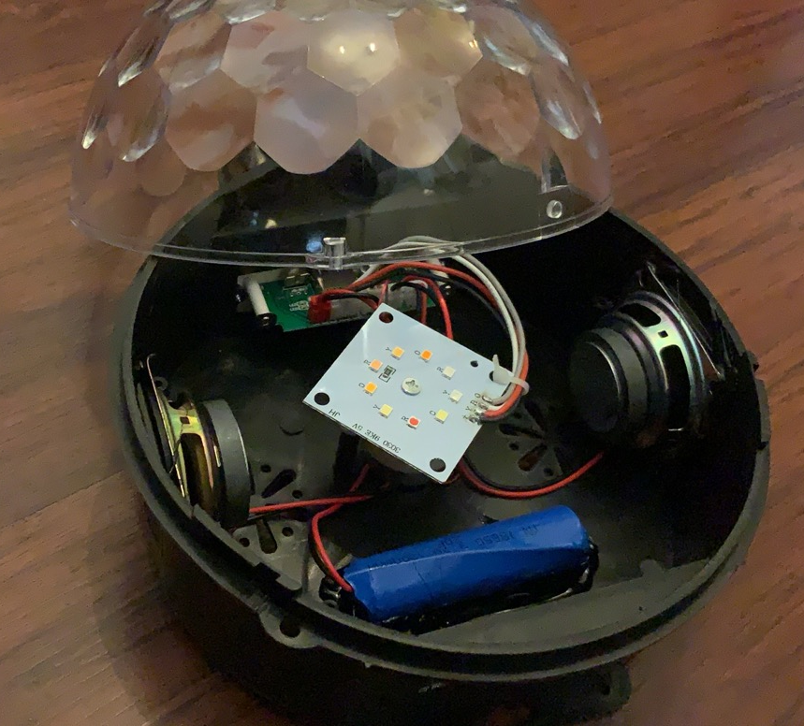
Functions
Module - Karaoke
LED
Servo
Speaker
Battery
LED & Servo
The Disco Lights
Karaoke
Speaker
The Music

Slide 4
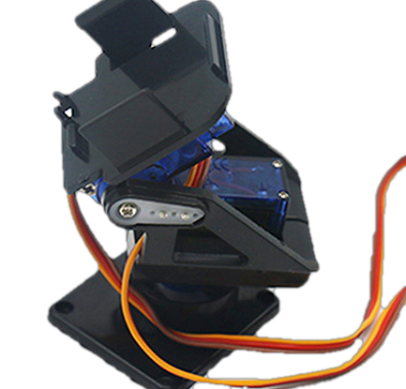
Functions
Modules - Camera
- Smooth live video streaming
via a light-weight chip
- Two Degrees of freedom camera pan

Slide 5
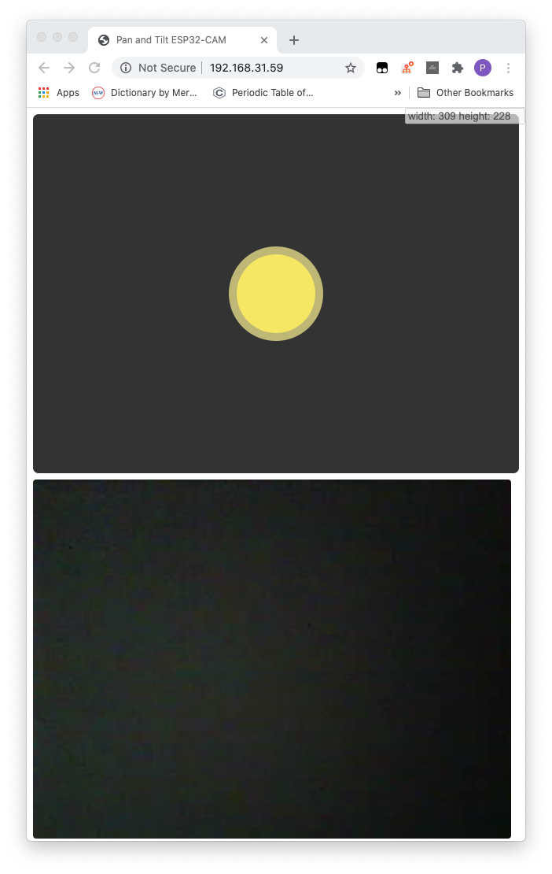
Functions
User Interface via Web (Cross Platform)
Virtual Camera
Pan Controller
Video Streaming
Window

Slide 6
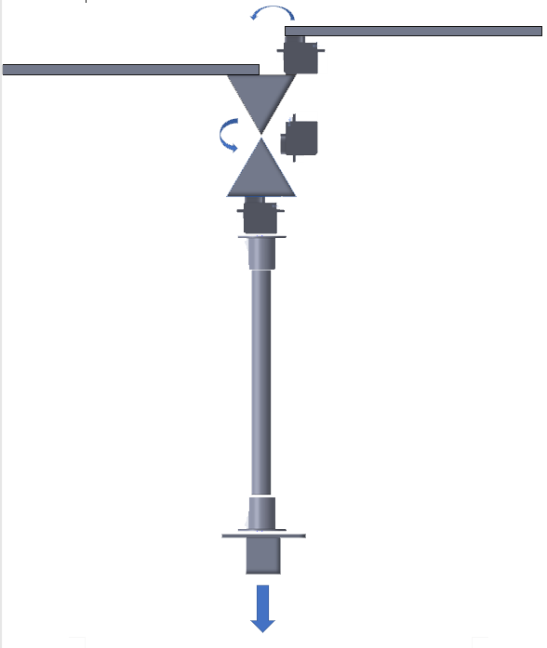
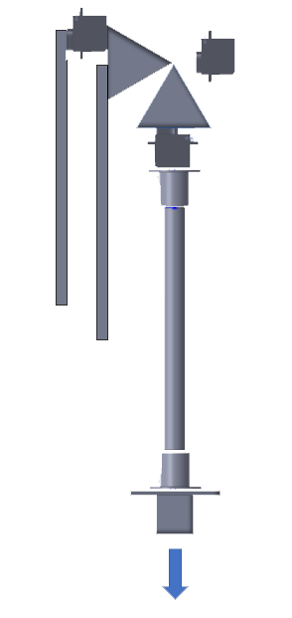
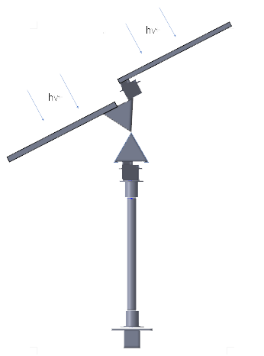
Functions
Modules - Solar Panels
photosensitive sensor
solar panel
solar panel
- Folding
- “Sunflower”
- Mobile charging station
servo
steering platform
Hollow pole
Power bank
Standard charging port
Access to the
modular interface

Slide 7
Functions
Module Design - Robotic Arm
- Replace the module
- Connect the charging wire
- Other functions（mining, specimen collection）
Power bank
Module 1
Module 2
Pincar 2
Pincar 1
container

